Slide 1
ThermoML

Slide 2
ThermoML History
2002 Version 1
2003 Version 2
Addendum for other Data types:
2006 Version 3
2010 Version 4
Addendum speciation and complex equilibria (2011)
2017 Version 5
Initial Project Proposal (v1)
Addendum for uncertainty (2003)
2006 IUPAC Approval
Addendum for some properties of biomaterials (2010)
Revision and addition of properties, phase characterization, and processing history
120 thermodynamic properties
Pure or multicomponent systems
Chemical reactions
Experimental data only
Critically evaluated
predicted
Equation representation
Added methodologies and terminology

Slide 3
Improvements
Restructure
Improved Representation capabilities for phase
Improved representation of reference states
Improved Annotation of Fields
New Properties

Slide 4
Comparisons
New components are circled, arrows indicate where components have moved.

Slide 5
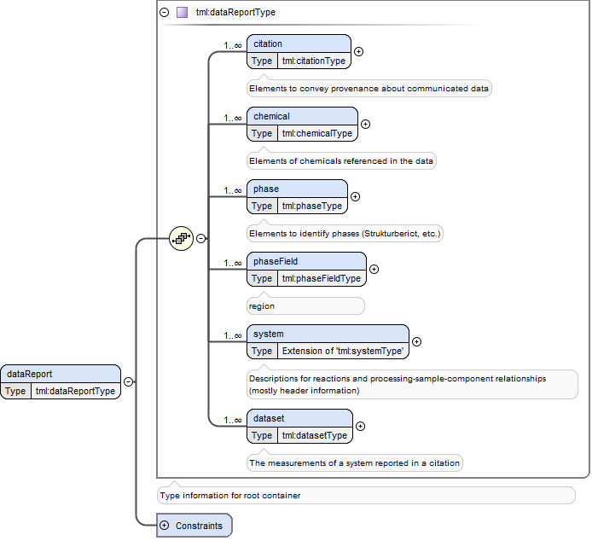
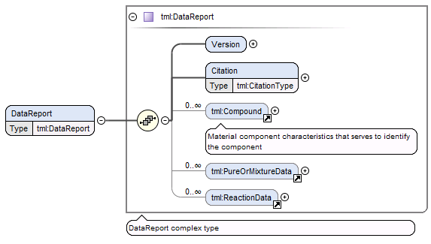
Old and New structure
Similar citation structure
Similar compound structure
Purity information stored in system
All reaction and mixture data now stored in Phase, Field, System and Dataset.

Slide 6
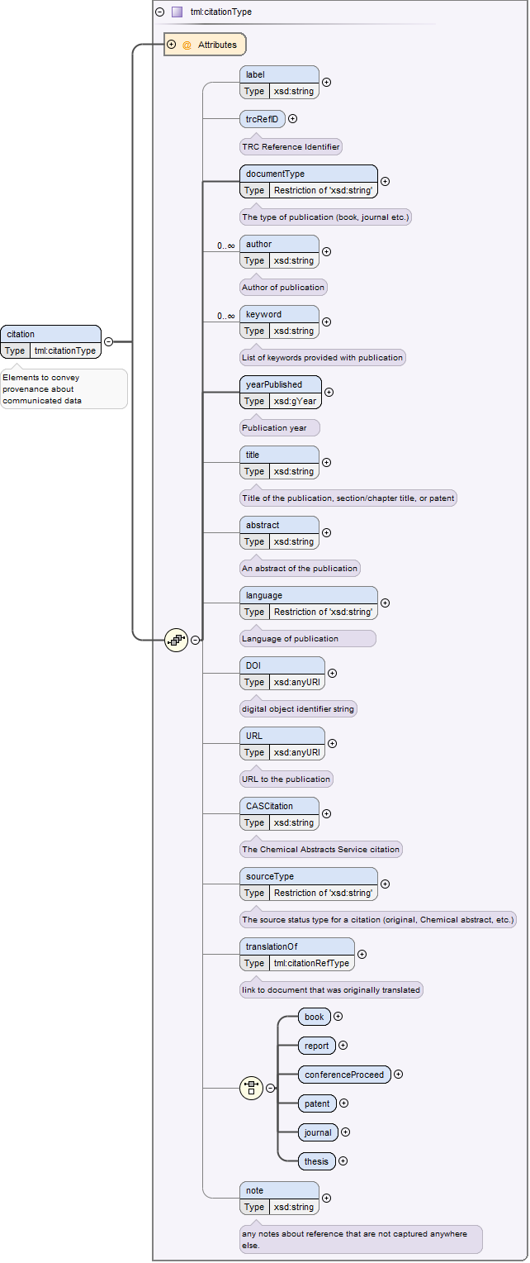
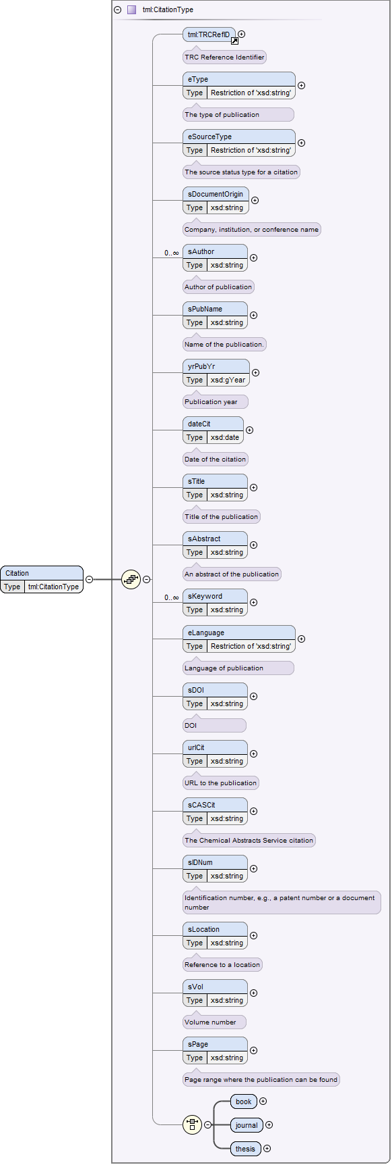
Old and New citation
Key ref now useable
URL is defined as AnyURI type
Original Documents for translations can be input
Specific attributes for thesis, journal, report, etc.

Slide 7
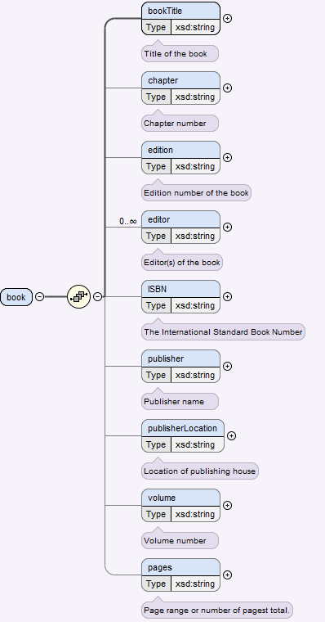
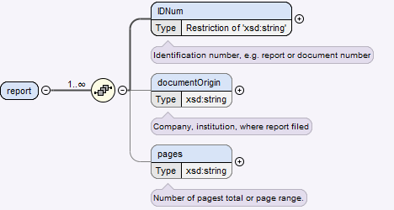
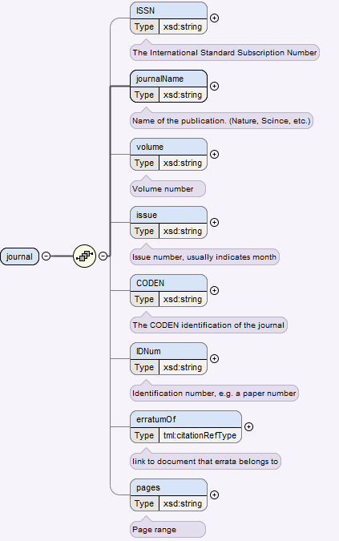
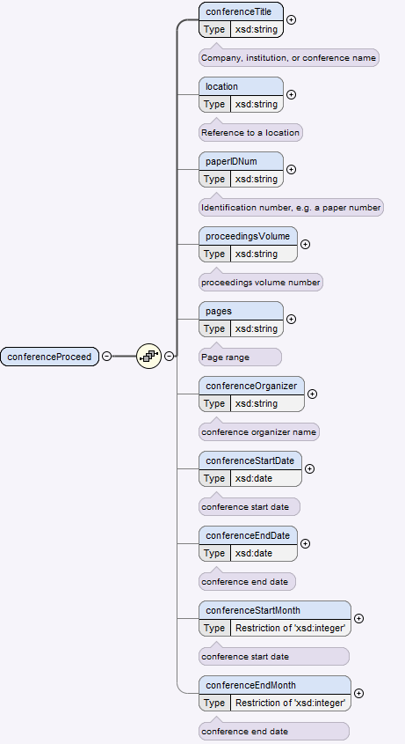
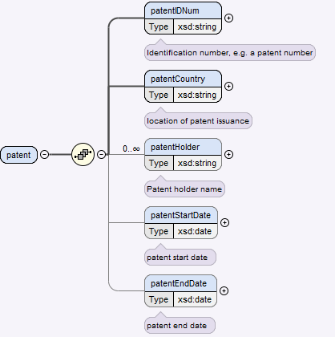
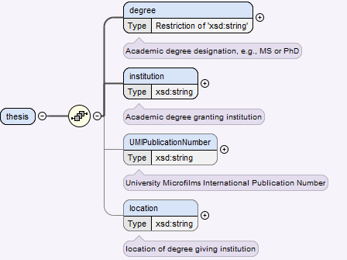
Examples

Slide 8
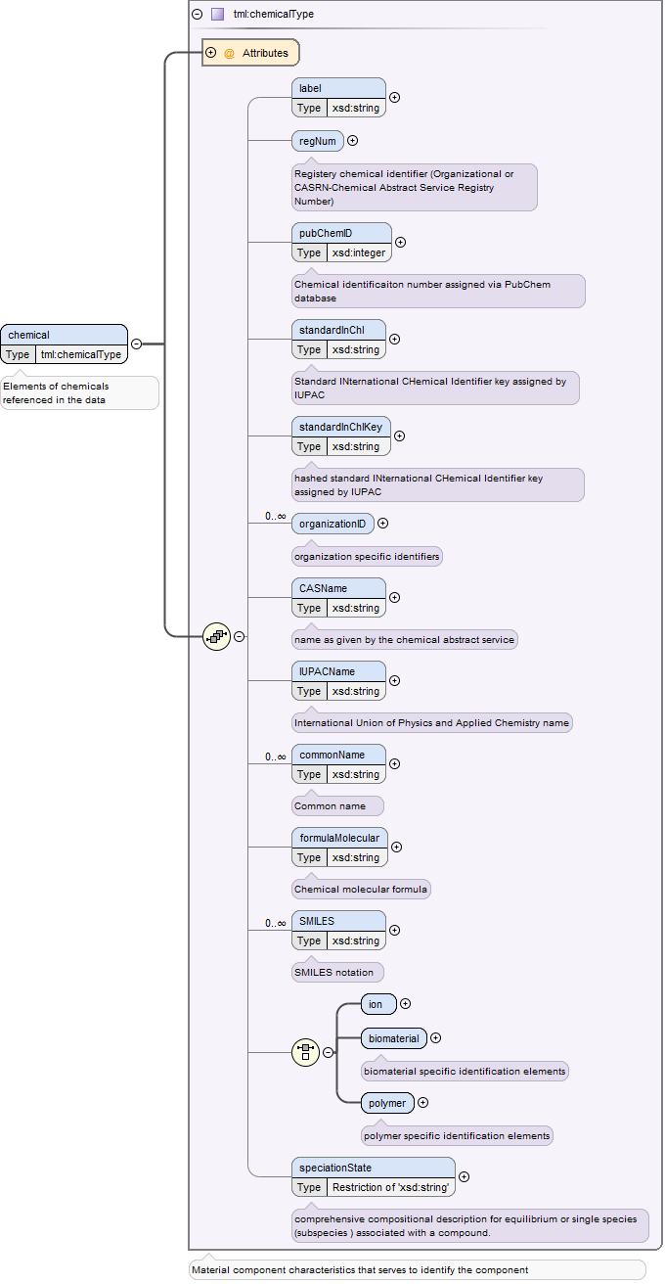
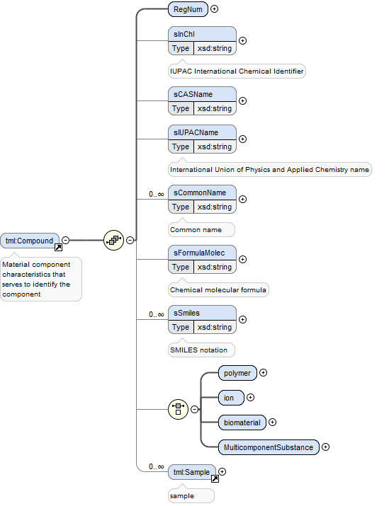
Old and new chemical
Multiple component substances can now be better characterized
More Identification standards
Organization ID used for internal data maintenance.
Sample now in system
Speciation state description

Slide 9
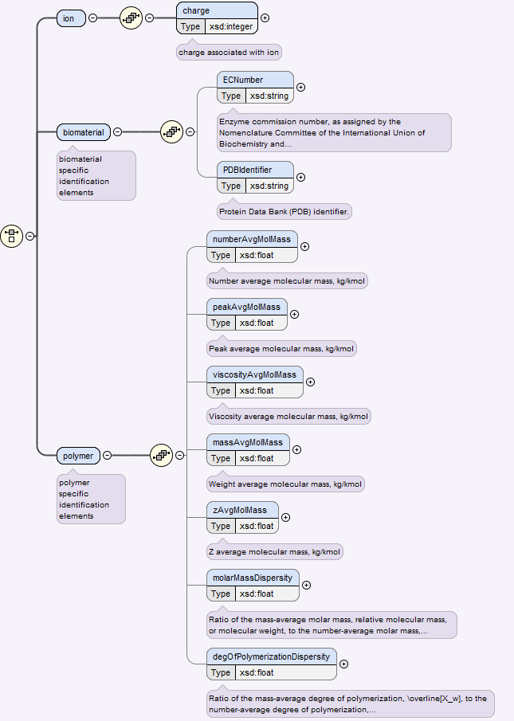
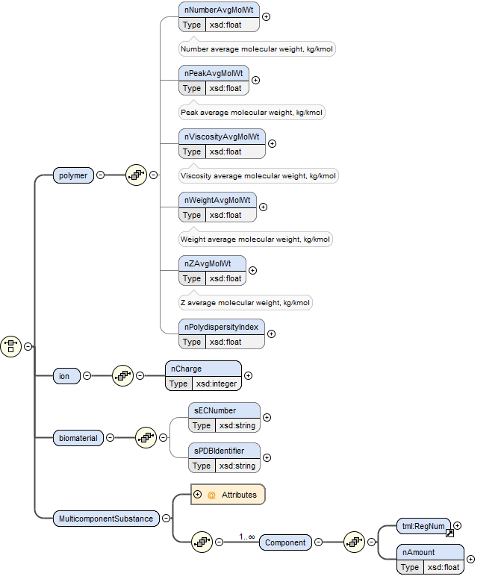
Old vs new Chemical
More documentation
Maintaining backwards compatibility.
Improved
Moved to system

Slide 10
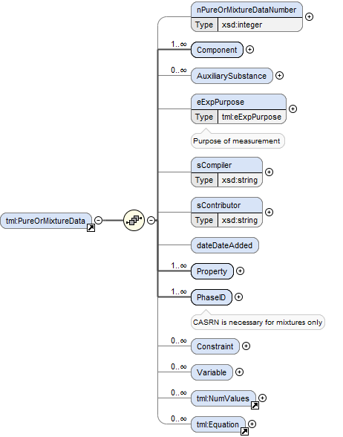
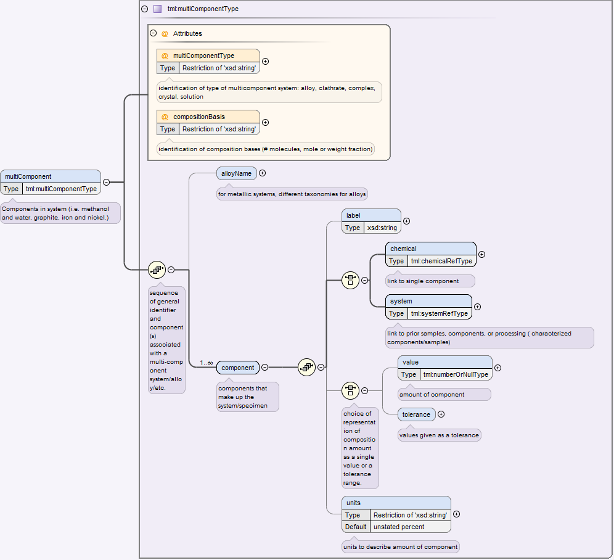
Pure and Mixture data restructure
Improved, Moved to system
Components may be linked to chemicals or systems (i.e same chemical measured before and after purification, or after heating/cooling/processing)
Components can be alloy names
Component values can have tolerances
Can sort on component types (alloy, clathrates, complex, crystal, solution)

Slide 11
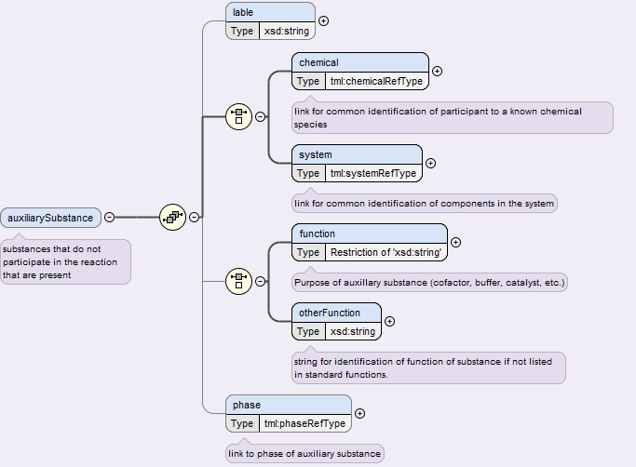
Pure and Mixture data restructure
Auxiliary components linked to chemical description
Other types of aux. substances can be input
Phase attributed with aux. substances.
Improved, Moved to system

Slide 12
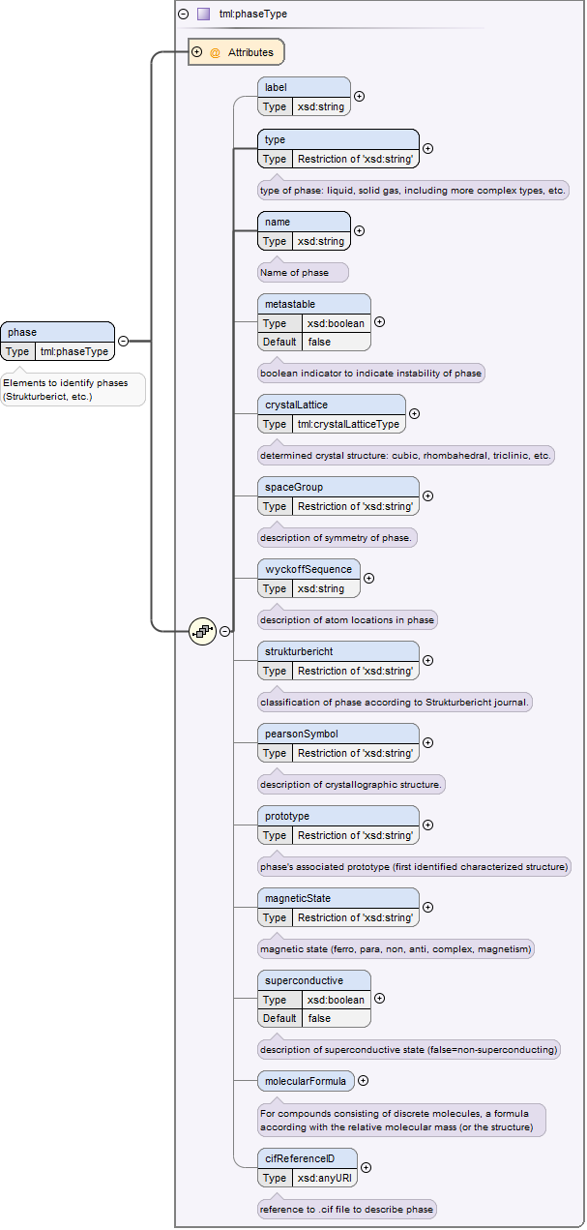
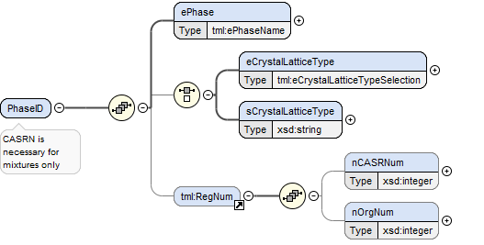
Pure and Mixture data restructure
Not in 5…., can be found in molecular Formula…
Booleans for:
Superconductivity
Metastability
Ability to link Crystal Identification File (CIF)
Stoichiometry can be captured
Many more options to characterize phase:
Strukturbericht
Magnetic state
Prototype
Wyckoff sequence
Space group

Slide 13
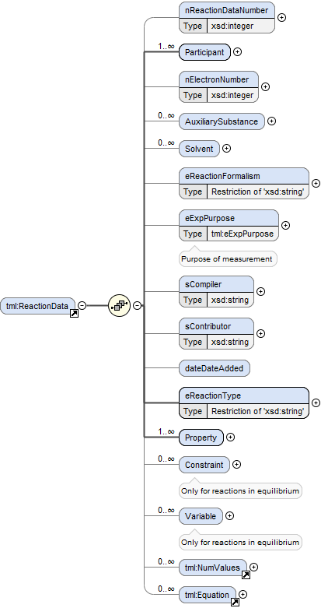
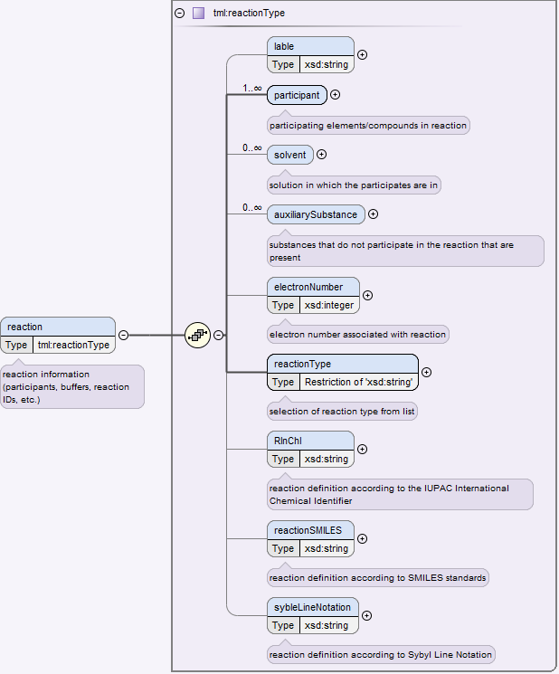
Reaction
Moved to system/reaction
dataset
More methods to capture reaction information in one location
Data structure similar for rest of dataset rather than having multiple different methods.

Slide 14
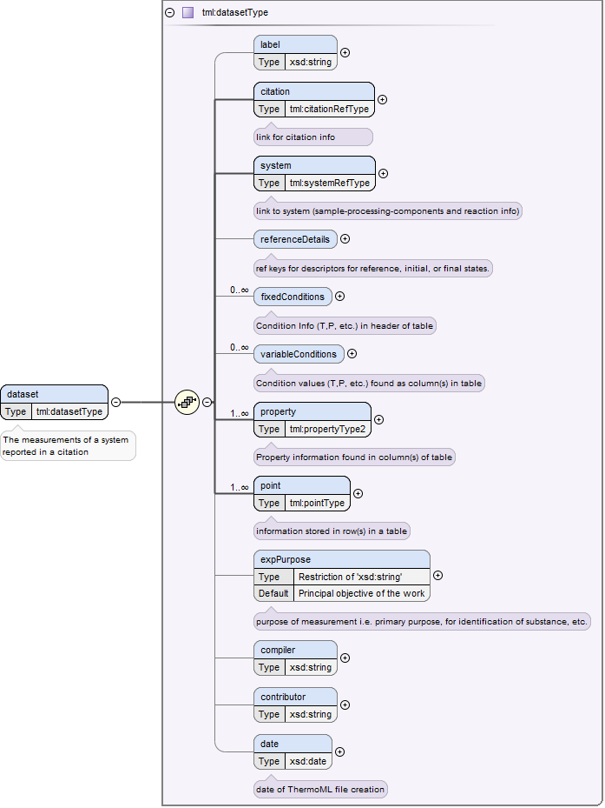
Pure and Mixture data restructure
Most components from pure or mixture data or reaction data are in dataset.

Slide 15
Pure and Mixture data restructure
More complex fields are put in multiple locations.

Slide 16
Pure and Mixture data restructure
More complex fields are put in multiple locations.
Unsure how equation is represented.

Slide 17
specifics
Most details described
key-ref links dotted
circled components used to draw focus for certain points that are also circled

Slide 18
dataReport
6 blocks + Constraints (links)
Citation Data
Chemical Data
Phase Data
Phase Field
System Data
Dataset
Constraints (contains keys that link between other 5 blocks)
Keyrefs are found throughout the 5 blocks, think of as keyholes for the keys found in the constraints (keyrefs are found in data)

Slide 19
dataReport/ citation
Many fields to represent provenance of data
Attribute keyref to link data points with a well defined reference
Modified and annotated for simplicity

Slide 20
Data Report/ chemical
Many identifiers per chemical/components used in experiments
Attribute keyref to link data points to components with provenance of component identification
Speciation state
Standard Inchi and InchI key
Organization ID added for customization by specific users

Slide 21
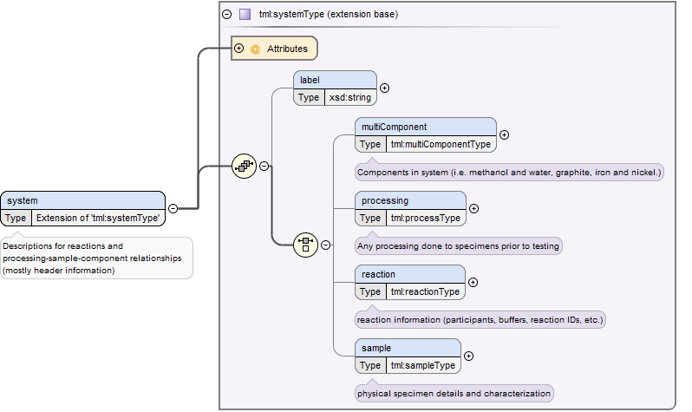
Data Report: System
4 components
Sample description
Reaction description
Sample Processing
Multi-component def.
Initial Sample/Specimen
Al / Mg alloy
Heat Treated specimen
400°C
5 um GS
3 hours
Argon atmosphere
Water quench
99wt% 1wt%
Ingot

Slide 22
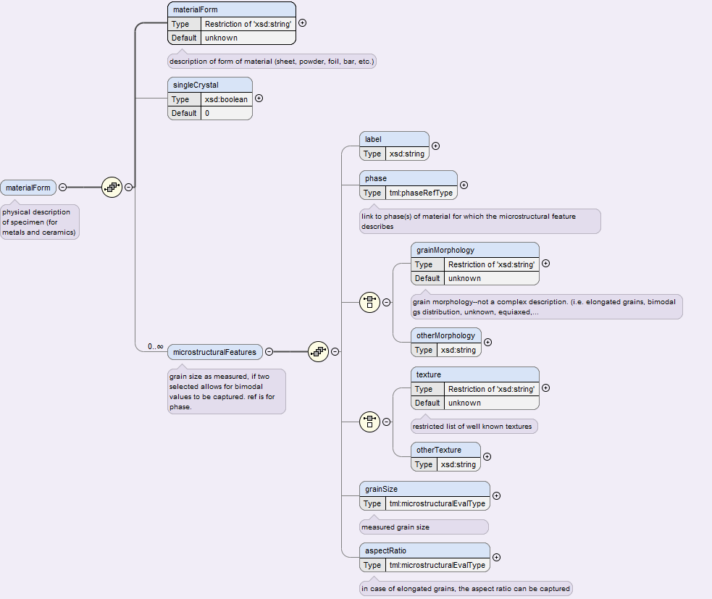
DataReport/System/Sample/ materialForm
Allows for single crystal identification
Key ref for specifying phases present (instrumental for microstructural representation)
Ability to define different common colloquial phrases for grain morphology
Texture definitions possible
Can capture microstructure:
Grain size information
Aspect ratio
phase associated with feature

Slide 23
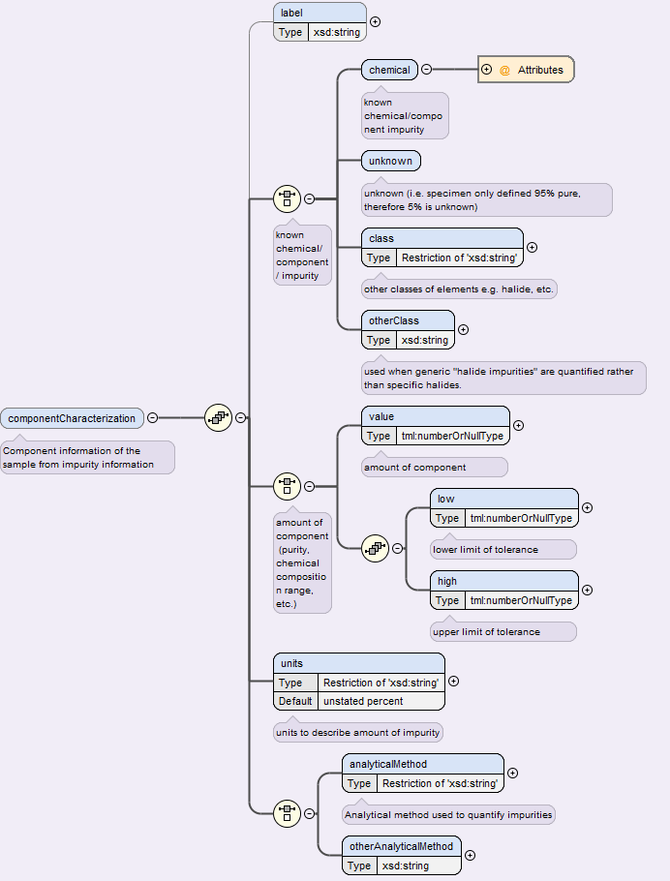
dataReport/system/sample/ componentCharacterization
Information about purity of feedstocks for alloy or inorganic materials
Describes method of purity determination
Allows for metadata linked to purity of specimens to be determined through system keyref
Additionally allows for
suspect or ill defined data to be captured
95% pure… 5 percent ?
Range of compositions (for alloys)
All prior units (wppm, appm, w%, a%, mole fraction, etc.)

Slide 24
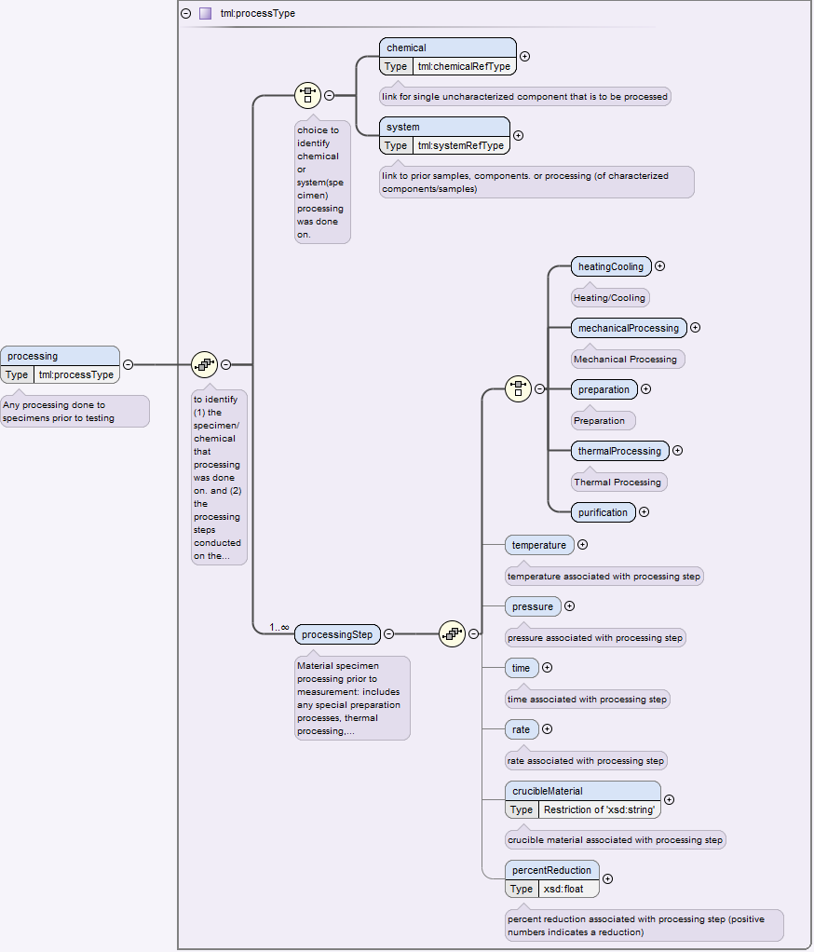
dataReport/system/ processing
Allows for the capture of multiple processing steps in order to be captured.
Allows for metadata about processing to be captured as well.
Melted WQ
HT 500C
HT 550C
WQ
HT 600C
HT 700C
HT 550C
FURNACE COOL
ANNEAL
FURNACE COOL
ANNEAL
WQ

Slide 25
Melting & Casting
Arc Melting
Induction Melting
Radiation/Furnace Melting
Vacuum Degassing
Deposition Processing
Chemical Vapor Depositing
Physical Vapor Depositing
Sputter Depositing
Ion Beam Depositing
Powder
Atomization Processing
Electrolysis Processing
Chemical Reducing
Mechanical Crushing
Chemical
Cleaning
Etching
Casting
Electrodeposition
Rapid Heating/ Modified Solidification windows.
See below.
Type:
Methods:
Type:
Deforming
Pressing
Die Pressing
Isostatic Pressing
Milling/Grinding
Machining
Acoustic Wave
Ultrasonic
Shock Wave
Forming
Extruding
Rolling
Machining to Shape
Machining Surface
Bonding
Ball milling
Mortar and pestle
Filing
Methods:
Melting
Sintering/Liquid Phase Sintering
Radiation Sintering (Furnace)
Spark Plasma Sintering
Laser Sintering
Resistance Sintering
Annealing
Solution Annealing
Heat Treatment
Same as above.
Precipitation Annealing
Relaxation Annealing (e.g. powder before x-ray)
Type:
Methods:
Cooling
Air
Furnace
Quenching
Water Quenching
Ice Quenching
Liquid Nitrogen Quenching
Rapid Cooling
Atomization Processing
Melt Spinning
Splat Cooling
Rapid Heating
Microwave Processing
Electron Beam Processing
Laser Processing
Modified Solidification
Oil Quenching
Directional Solidification
Seeded Solidification
Single Crystal Solidification
Zone Refining
Resistive Heating
Casting
Type:
Methods:
Notes:
Changes:
We are note sure exactly how to add the additional important inputs you suggest for electrodeposition, but will be discussing this later today.
Boris’ and my brief discussion earlier lead to: sounds good if we need it we’ll have it then.
We will leave bonding in pressing, if it moves to another type it shouldn’t be an issue.
I agree with the additions to milling and grinding
Would you think we would want to group: Bar/Ball/Rod milling as the title
Zone refining was moved to modified solidification.
Changed naming scheme in Modified solidification from ____ solidifying to ____ solidification
Removed CZ from solidified structure
To the specific annealing methods issue (whether or not to specify different processes)
What we propose is to include the specific cases (precipitation annealed, etc.) for cases where the only information would be: “the alloy was solution Annealed.” With no details of temps and times, otherwise we would suggest students to input the actual processing parameters. Though in the background, for searches, we would consider all annealed cases to be treated as a generic anneal.

Slide 26
Data Report phase
Many ways to identify a material, developed in a robust way such that only known identifiers can be represented.
Contains keyrefs id for phase linking
Types: Crystal, Glass, Unknown Solid, Liquid, Gas, Unknown/Supercritical fluid, inert media at 1 atm, cholesteric liquid crystal, nematic liquid crystal, smectic liquid crystal, unknown-type liquid crystal, (QuasiCrystal?), (CondensedPhase),(Undercooled Liquid)
The rest is for crystal identification
Red= unsure if to include

Slide 27
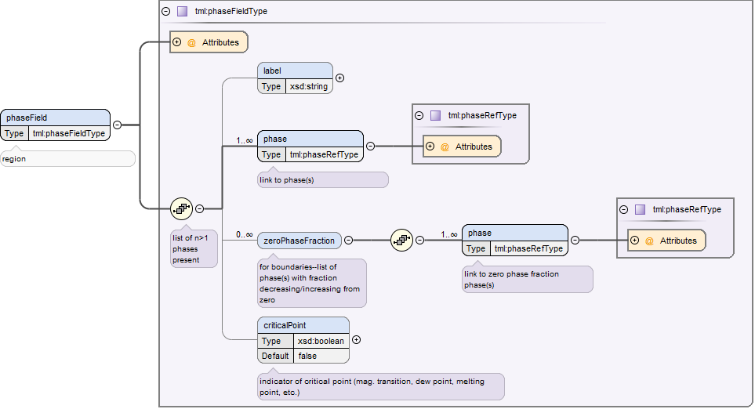
Data Report phaseField
Key ref for phase field for attributing phases to datapoints
Phase key ref to link identified phases
Concept of zero-phase fraction introduced to differentiate different key phase transitions
Boolean for critical points to easily search for critical points.

Slide 28
Zero phase fraction representation
liquidus
Liquid, solid
solid
solidus
Liquid, solid
liquid
eutectic
Liquid, solid1, solid2
Liquid
peritectic
Liquid, solid1, solid2
solid 2 (austenite)
monotectic
Liquid, liquid1, liquid2
Liquid
phases involved
zero
phase

Slide 29
dataReport/dataSet
Every data set will have:
keyref for citation
keyref(s) for System components
key-ref for reference details
keyref(s) for phase(s)
Associated Variables
(can by dynamic-variable or static-fixed)
Property description
Data Point
Xi (wt%) | T (K) | H (kJ/mol/K)
0.20 | 800 | 515
0.40 | 900 | 615
0.40 | 800 | 435
Fixed
Crucible=Graphite
Atm=Vacuum
P=101 325 Pa
Tref=650K

Slide 30
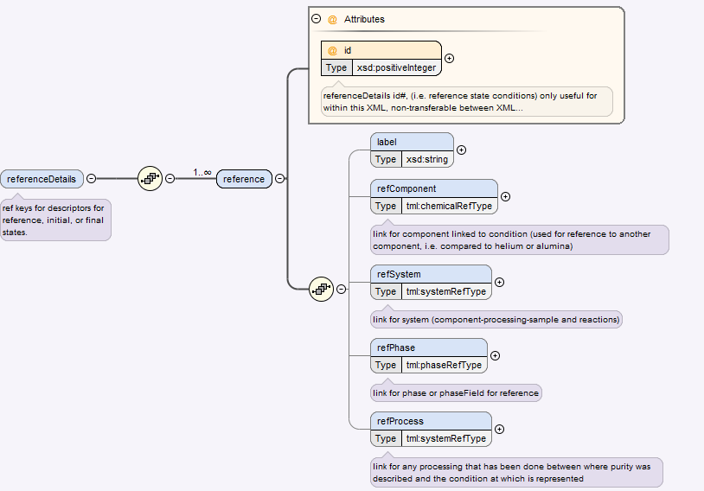
dataReport/dataSet/ referenceDetails
Reference information can be stored, even if it is just a counter for an iterative reference state (like in drop calorimetry)

Slide 31
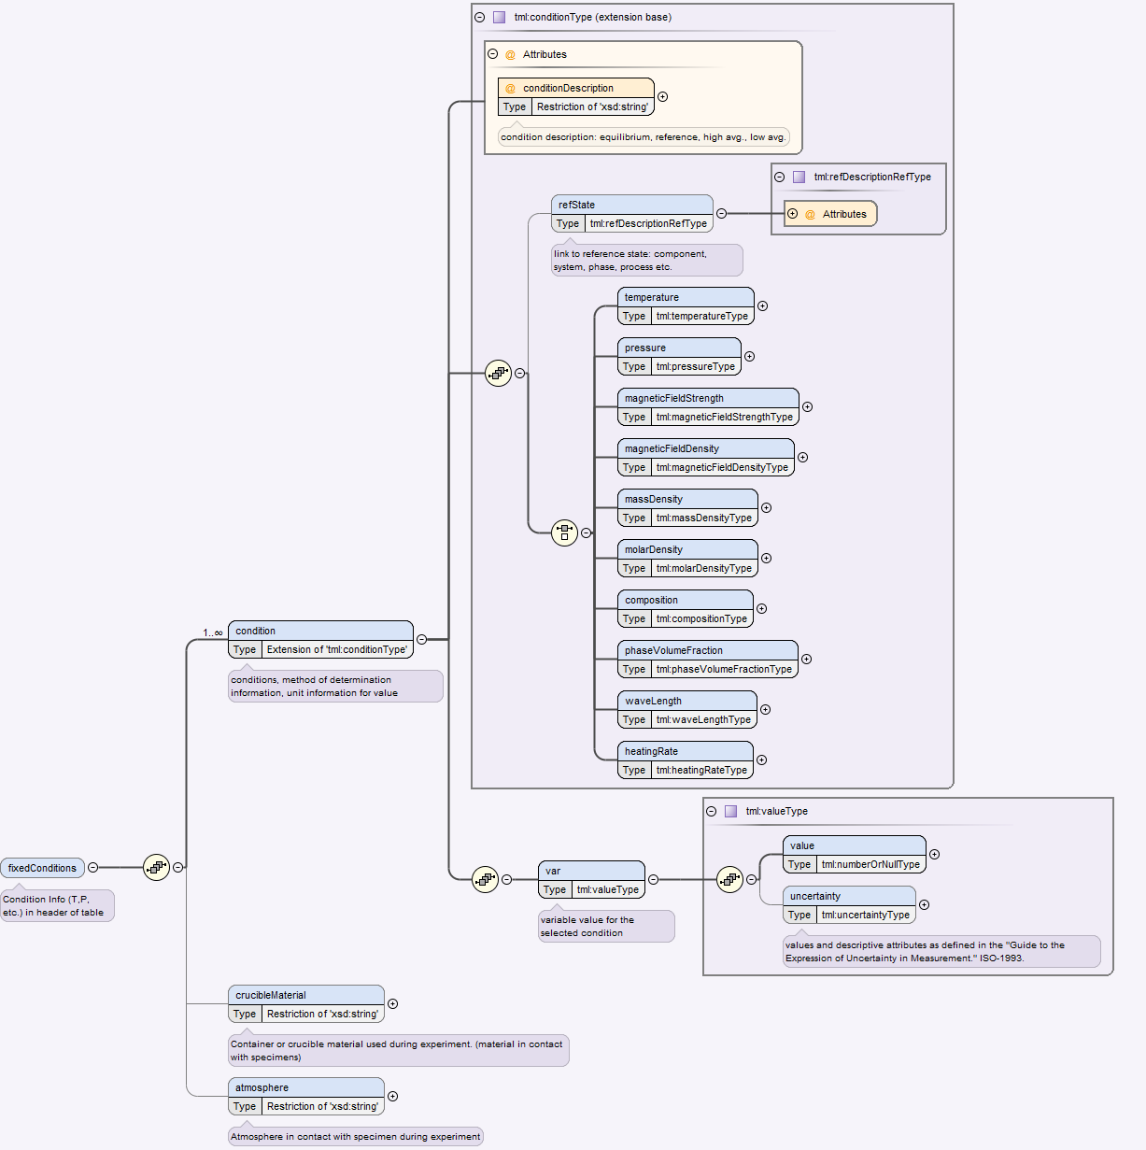
Data Report Data Set Variable
Variables can be:
constant/fixed or
Dynamic/variable
Representation of reference condition(states) is supported by both:
an attribute to describe the condition
a reference to a key id for a specific reference point/state
If constant the fixedVariable Type will be used, where the value is stored once
rather than many times
as would be done with the variableConditions

Slide 32
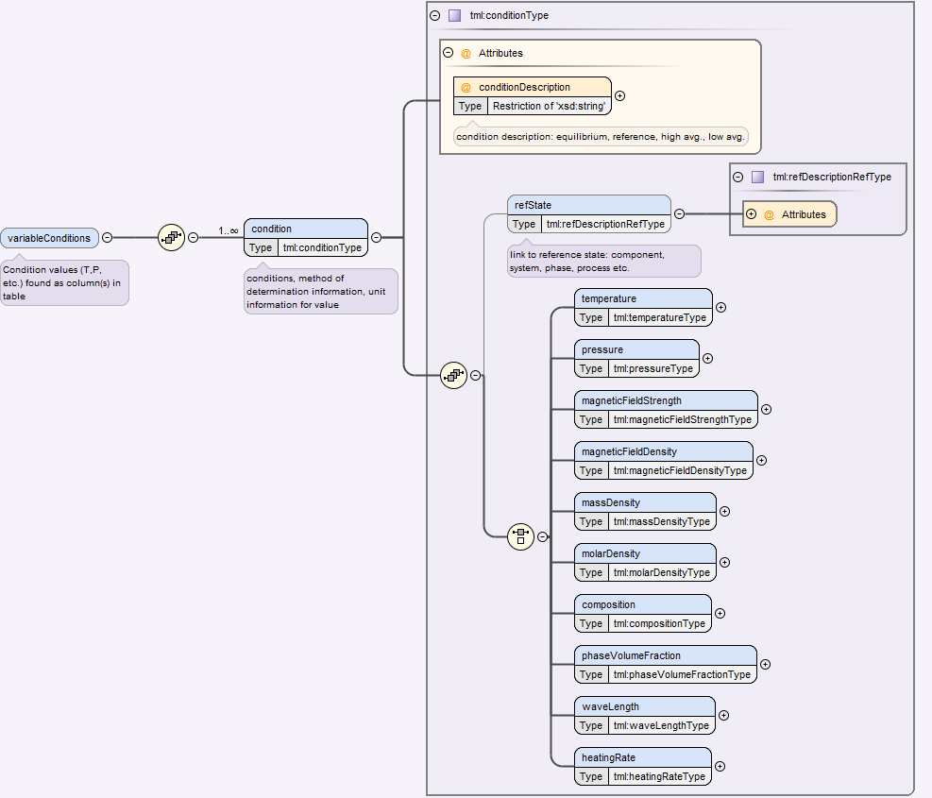
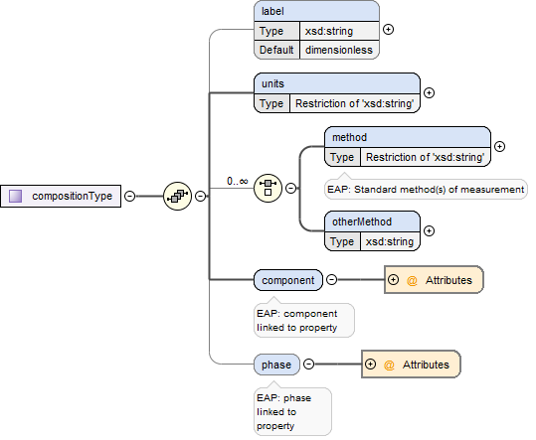
Data Report Data Set Variable
Variables can be constant or a dynamic number throughout the dataset.
This could also be used with a moving reference state (like in drop calorimetry)
The metadata about the properties is stored here
Identifier for data
Units of measurement (default SI)
List of standard Method(s) for measurement
Other Methods non list input
Component keyref
Phase keyref

Slide 33
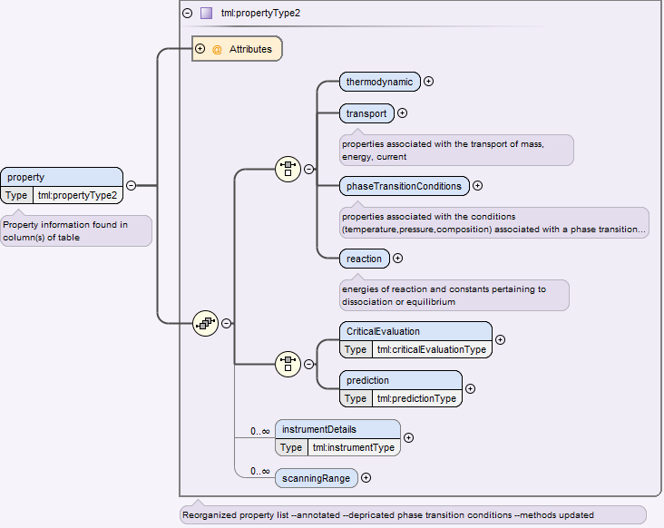
Data Report Data set Property
Organized into four main subsets
Thermodynamic
Transport
Phase transition conditions
reaction
Indicators for either:
critical evaluation methods
prediction methods
Instrument details can also be stored here

Slide 34
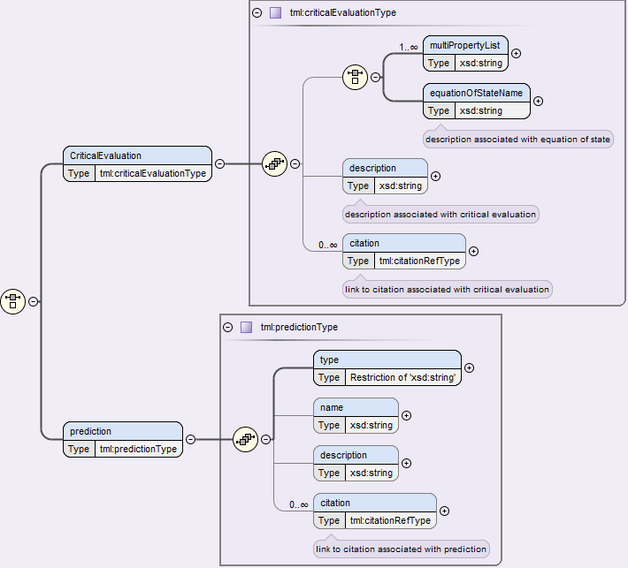
dataReport/dataset/property critical evaluation or prediction

Slide 35
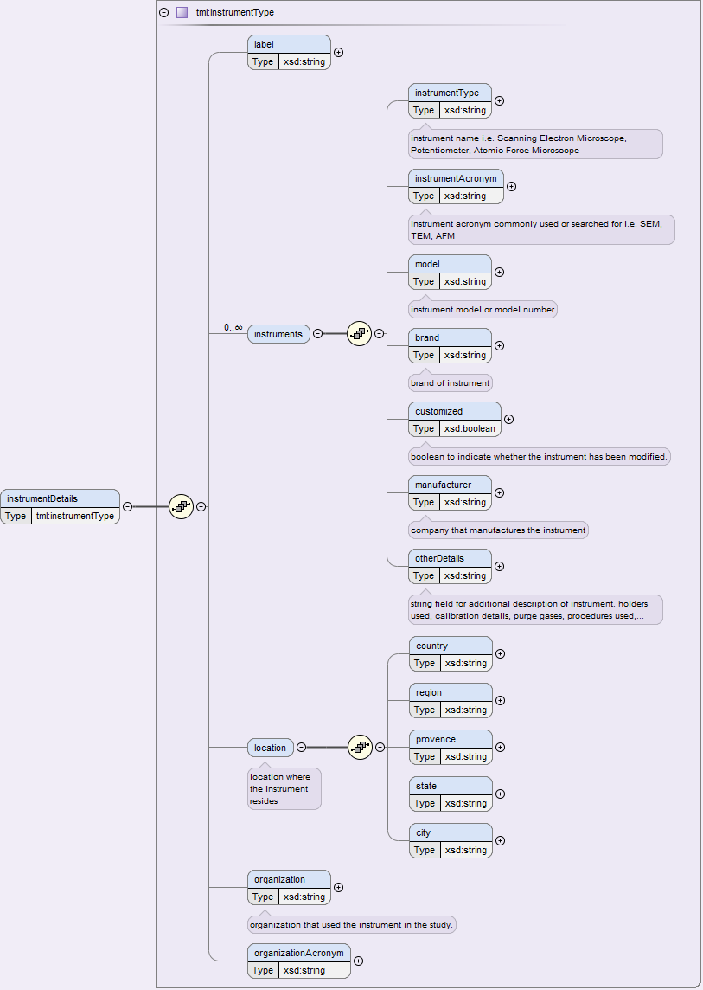
dataReport/dataset/property instrument details

Slide 36
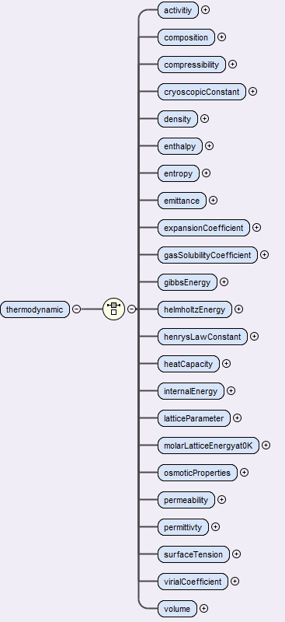
dataReport/dataset/property thermodynamic

Slide 37
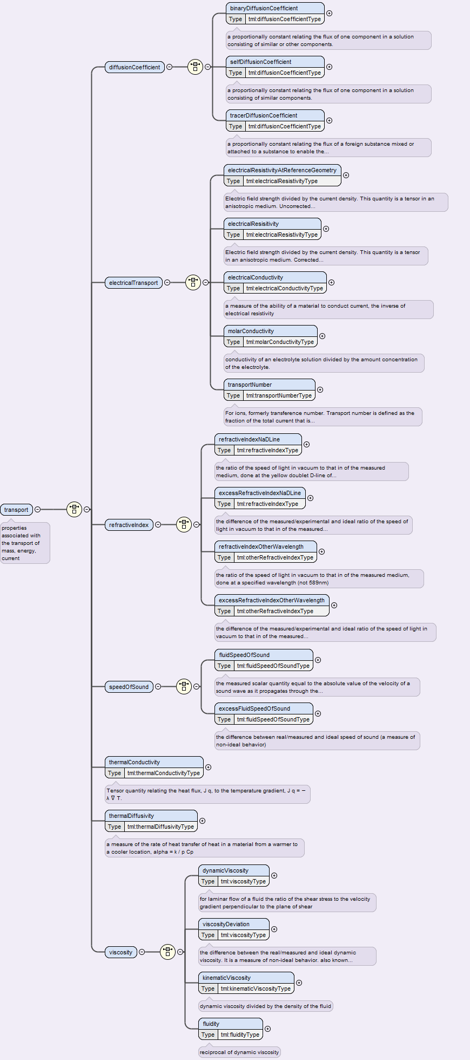
dataReport/dataset/property transport

Slide 38
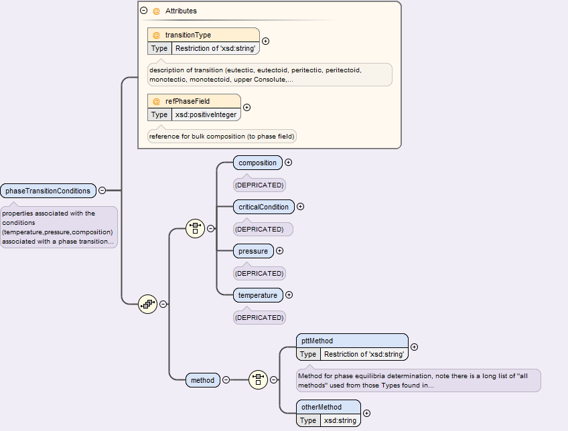
dataReport/dataset/property phaseTransition

Slide 39
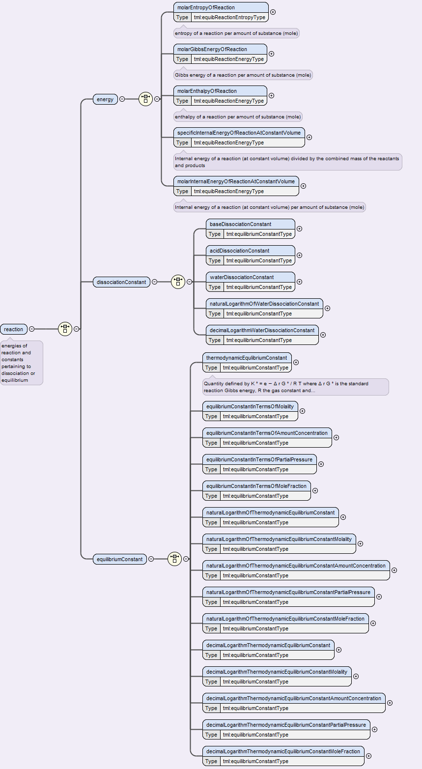
dataReport/dataset/property reaction

Slide 40
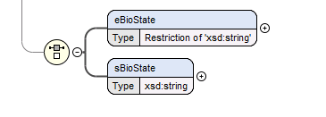
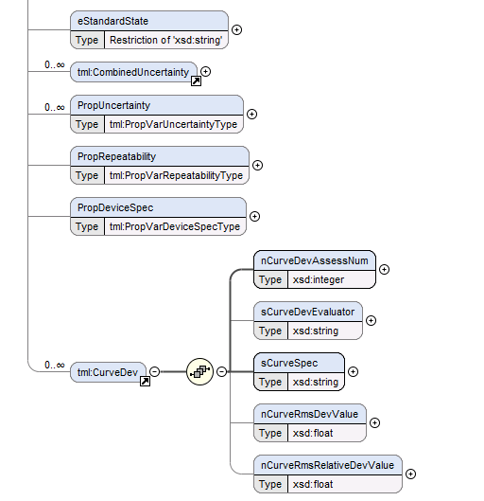
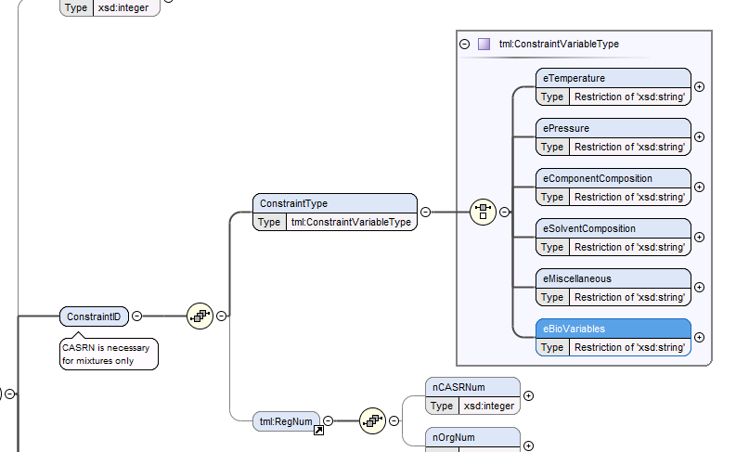
April 20-end
I think I’m missing this in THERMOML 5
Missing:

Slide 41
Things unsure how they translate:

Slide 42
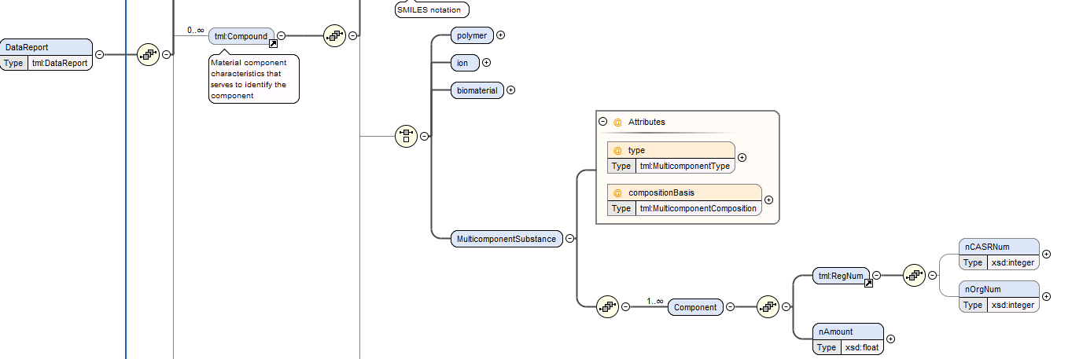
From 2011 thermoML
Is it still a component? Or is it for a molecular formula (phase) ?

Slide 43
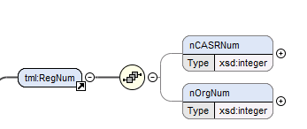
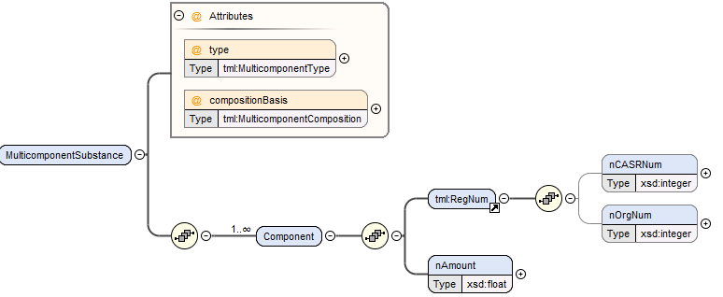
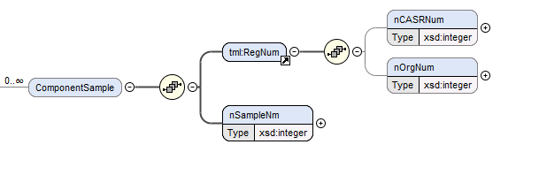
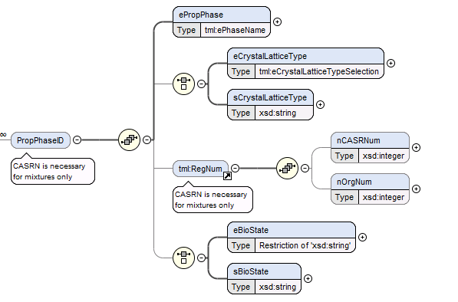
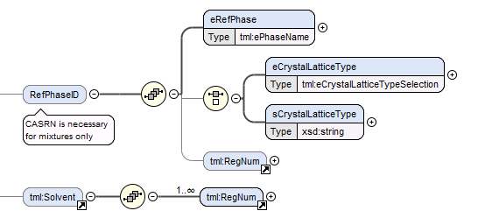
Tml:Reg Num
Can this be replaced by a chemical-keyref?

Slide 44
The rest of these are just ones I made, I just wanted them all in one place.

Slide 45
Future Work
Determine zero-phase region representation
Finish identification of properties that require keys for:
Solute/Solvent (components and phase)
Component only
Phase + Component
Reference State Definitions
Solution definitions
Reactions definitions
XML Version 1.0 or 1.1
change xml version or have it compatible? Not sure if this is already accounted for, oxygen said it was an issue.
Crucible/Atmoshere for method/data sets
Map all key refs in the constraints section
Remove step type

Slide 46
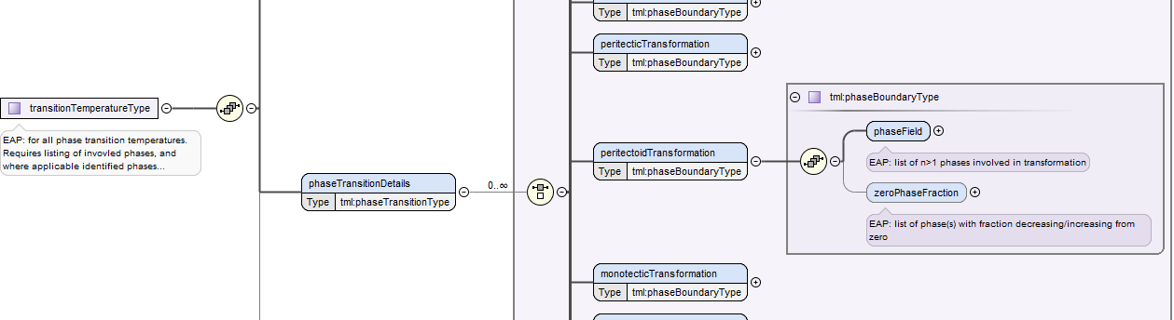
Zero phase fraction representation
Indicative of initiation of phase transformation. (i.e. 0% of new phase)
Creates phase field:
List of n>1 phases involved
Creates zero Phase Fraction
List of phase(s) with fraction decreasing, or increasing from zero

Slide 47
Zero phase fraction representation
liquidus
Liquid, solid
solid
solidus
Liquid, solid
liquid
eutectic
Liquid, solid1, solid2
Liquid
peritectic
Liquid, solid1, solid2
solid 2 (austenite)
monotectic
Liquid, liquid1, liquid2
Liquid
phases involved
zero
phase

Slide 48
Reference Implementation
Either
change each method type to have an option of being a reference or not (bool) and adding a key that would link with other data sets that required defined refs.
(think this would just make more fluff)
Create DataReport>DataSet>Reference>Temp/Pressure etc. where a single key could be stored, which could indicate a reference, then select what is referred
Change point type to have different measurement representations

Slide 49
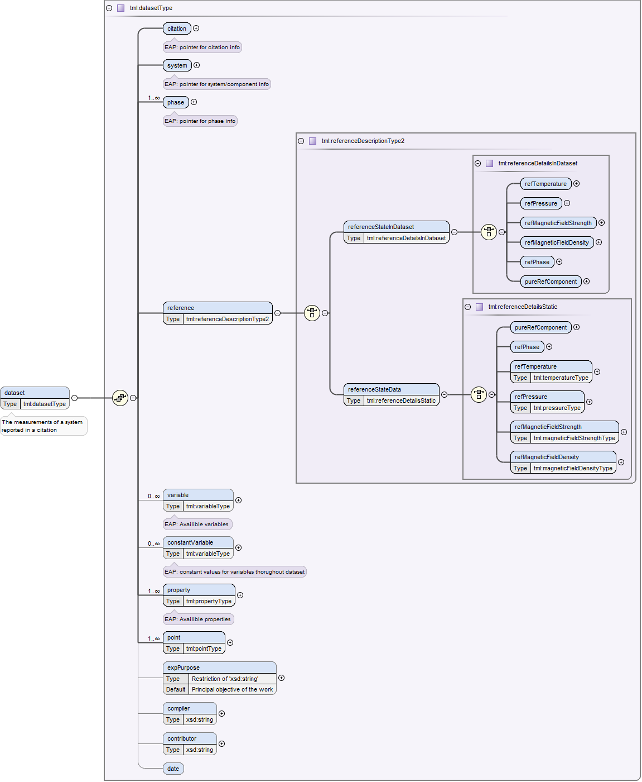
Reference Implementation
Either
change method type to have an option of being a reference or not (bool) and adding a key that would link with other data sets that required defined refs.
(think this would just make more fluff)
Create DataReport>DataSet>Reference>Temp/Pressure etc. where a single key could be stored, which could indicate a reference, then select what is referred
Change point type to have different measurement representations

Slide 50
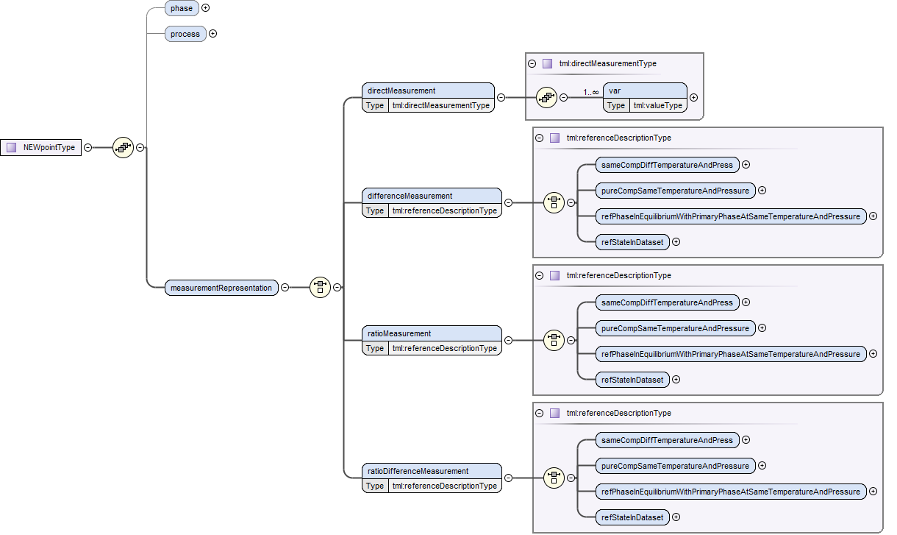
Reference Implementation
Change point type to have different measurement representations
Might want a combination of both of these ideas….
Have the point type point back to the reference information....
though what about when the reference is not constant...

Slide 51
Reference Option 1
Might want a combination of both of these ideas….
Have the point type point back to the reference information....though what about when the reference is not constant...

Slide 52

Reference Option 2
Points to variable table
Either
change attribute type to have an option of being a reference or not (bool) and adding a key that would link with other data sets that required defined refs.
(think this would just make more fluff)
Create DataReport>DataSet>Reference>Temp/Pressure etc. where a single key could be stored, which could indicate a reference, then select what is referred
Does this need a value?
Unsure how to set defaults?
(mag field etc. when not given)

Slide 53

Reference Option 3
Keyref to Dataset for datapoint
Actual reference data
Keyref to Dataset>Variable for datapoint

Slide 54

Crucible/atmosphere
Option 2: add to dataset
Now:
Possible Modification:

Slide 55


Crucible/atmosphere
Option 1: add to Point
Now:
Possible Modification:

Slide 56
Thoughts July 25, 2016
Need to rework organization of properties in subsets
Need to add crucible/atmosphere during experiment
Think I have zero phase field represented
Might have to rethink some properties done prior before to zero phase field, normal melting point etc. otherwise they could be defined in multiple ways rather than one way.
Need to talk to Andrei
Reference could possibly be stored as a constant variable…
Missing Single Crystal identification—in Chimad in materialForm
Missing wykoffSequence anything—in chimad
Missing Specimen Sample Geometry field (material name, geometry, in chimad
Add Reported Grain size to specimen sample?

Slide 57

Notes from CHiMAD
Not really using any of our base….
No camel case
Apparently we are missing some things they want
Instrument ID
Things they have made:
SpaceGroup type
WyckoffSequence (ours is blank)

Slide 58

Notes from CHiMAD
Not really using any of our base….
No camel case
Apparently we are missing some things they want
Instrument ID
Things they have made:
SpaceGroup type
WyckoffSequence (ours is blank)

Slide 59

Notes from CHiMAD
Accounts for calibration data

Slide 60

Notes from CHiMAD
Don’t understand why they have so many measurementss for thermal analysis…. (and that it is a series, not a choice) also not accounting for cooling rate.
Types for units….

Slide 61
ThermoML
Camel case for all values (onlyCapitalizeSecondWordAndBeyond)
Limited number of free entry

Slide 62

Old ThermoML

Slide 63

Old ThermoML

Slide 64


Data Report: System
1
4
3
4 components
Sample description -keyref for Material ID -keyref for system Material ID -material supplier -purity metadata
Reaction description -keyrefs for involved Material IDs -key for solute/solvent material ID
Sample Processing -contains thermal/mech. History of specimens -keyrefs to material ID
Multi-component def. -keyrefs for linking multiple components (each compo- nent has a unique keyref)
2

